Slide 1
Managerial Economics
Economist’s Guide
#1

Slide 2
IN THIS Unit
Nature and Scope of Business Economics
Opportunity Cost
Cost and Benefit
Rent Seeking Behaviour
Nature of Profits
Optimizing Techniques

Slide 3


Slide 4
Amcott Loses $3.5 Million; Manager Fired
On Tuesday software giant Amcott posted a year-end operating loss of $3.5 million. Reportedly, $1.7 million of the loss stemmed from its foreign language division.
At a time when Amcott was paying First National a hefty 7 percent rate to borrow short-term funds, Amcott decided to use $20 million of its retained earnings to purchase three-year rights to Magicword, a software package that converts generic word processor files saved as French text into English. First-year sales revenue from the software was $7 million, but thereafter sales were halted pending a copyright infringement suit filed by Foreign, Inc. Amcott lost the suit and paid damages of $17 million. Industry insiders say that the copyright violation pertained to "a very small component of Magicword."
Ralph, the Amcott manager who was fired over the incident, was quoted as saying, "I'm a scapegoat for the attorneys [at Amcott) who didn't do their homework before buying the rights to Magicword. I projected annual sales of $7 million per year for three years. My sales forecasts were right on target".

Slide 5


Why is Ralph fired?
A manager generally has responsibility for his or her own actions as well as for the actions of individuals, machines, and other inputs under the manager’s control.
Ralph was fired for his managerial ineptness

Slide 6

Who is a manager?
The one who directs the efforts of others, including those who delegate tasks within an organization such as a firm, a family, or a club
The one who purchases inputs to be used in the production of goods and services such as the output of a firm, food for the needy, or shelter for the homeless
The one who is in charge of making other decisions, such as product price or quality

Slide 7
What is Economics?
Going Through Different Situations……

Slide 8
Situation #1
The Walt Disney Company manages theme parks throughout the world, including Disneyland in California, Disneyworld in Florida, Tokyo Disneyland and Euro-Disney near Paris. These parks attract thousands of visitors a day. Besides spending money within the theme park, the visitors are also the customers of nearby shops, hotels, restaurants and transport services. Recently, the Walt Disney Company planned a large program of investments to upgrade Disneyland. Before commencing the investments, the company purchased much of the property around the theme park.

Slide 9
Situation #2
A personal computer’s internal memory handles the complex calculations for graphics and spreadsheets. During the summer of 1988, the management of Apple Computer anticipated a shortage of memory chips and bought several hundred million dollars of 1-megabit chips at an average cost of $38. To recoup this cost, Apple’s management raised prices across the entire Macintosh line. By January 1989, however the shortages in the memory chip market eased, with the average cost falling to $23. Apple, nonetheless, maintained the prices of its computers.

Slide 10
Situation #3
The Limits of Growth, one of the 1970’s most influential books, predicted that that the world would run out of gold by 1983, silver by 1988, and oil by 2003. The publication of the book coincided with a sharp increase in the prices of oil and other minerals. The Limits to Growth sparked an intense debate among policymakers around the world. Some experts, citing the sharp price increases, called for urgent government regulation to avert catastrophe. By contrast, however, most economists were confidently optimistic and argued that the price increases were a good sign.

Slide 11
Situation #4
Stella is 3 months’ pregnant. Both she and her husband, Frank work as system analysts in the same company. The company offers such couples the choice of eight weeks’ paid paternity or maternity leave - either the father or mother may take the leave but not both.

Slide 12



Slide 13

Curiosity #1
Why did the Walt Disney Company buy the surrounding property before upgrading the theme park?

Slide 14

Curiosity #2
Was it a correct decision on Apple not to reduce the price of its computers even when its cost has decreased?

Slide 15

Curiosity #3
Why were the economists confidently optimistic and argued that the price increases were a good sign when the whole world was panicking?

Slide 16

Curiosity #4
Whether the wife or the husband should take the maternity/paternity leave?

Slide 17
What is the common problem faced in all 4 Situations?
Scarcity (of resources, of time)
Why SCARCITY then?
Human Wants > Available Resources
Notes:
Whether the setting is a business, or nonprofit organization or home

Slide 18
Resources, Resources & Resources
Resources are Scarce in Nature
Resources have alternative uses
So WHAT then? Where does it lead to…..???
Need to make Decision on Choices Available
Notes:
Whether the setting is a business, or nonprofit organization or home

Slide 19
Managers making decisions on CHOICES Available
Marketing managers have the responsibility of for the cost of what they sell
Financial managers must bear the cost of financial resources
Government must set policies with respect to finite stocks of oil and gas
Parents have to balance career and family demands within the 24 hours of the day.
Notes:
Whether the setting is a business, or nonprofit organization or home

Slide 20

What is the main task of a manager?
To make GOOD and EFFECTIVE decisions

Slide 21

Why is it so important that a manager should be making GOOD and EFFECTIVE decisions??
To maximize the benefits with limited resources

Slide 22

How can a Manager make EFFECTIVE Decisions?
Identify Goals and Constraints
Nature and Importance of Profits
Understand Incentives
Understand Markets
Recognize the Time Value of Money
Use Marginal Analysis
Make Data Driven Analysis

Slide 23
Managerial Economics - Defined
The study of how to direct scarce resources in the way that most efficiently achieves a managerial goal/s.
Managerial Economics is the application of economic theory and methodology to decision making problems faced by private, public and non-profit organizations.

Slide 24
Studying Managerial Economics
Foundation of business decision making
To estimate economic relationship
Useful to understand business environment
Useful for pricing decision
Prediction of relevant economic quantities

Slide 25

Why …. Managerial Economics?
In each case, a sensible analysis of what decision to make requires a careful comparison of the advantages and disadvantages (often, but not always, measured in money terms) of alternative courses of action.
These decisions are also all economic decisions.

Slide 26

Managerial Economics - OBJECTIVES
To provide a guide to making good managerial decisions
To use formal models to analyze the effects of managerial decisions on measures of a firm’s success(sheds light on cost, demand, profit, competition, pricing, compensation, market entry strategy etc.)

Slide 27


Is Microeconomics and Managerial Economics the same??

Slide 28

Microeconomics Vs. Managerial Economics
Microeconomics focuses on the analysis of the market - its descriptive
Managerial economics focuses on managerial behavior - its prescriptive

Slide 29
What does Managerial Economics do?
Brings the various functional areas of business together in a single analytical framework
Integrates material from other disciplines
Reinforces and enhances understanding of those subjects

Slide 30
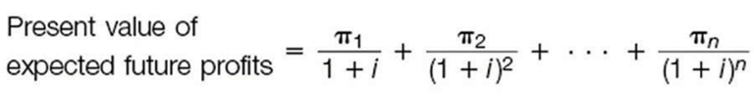
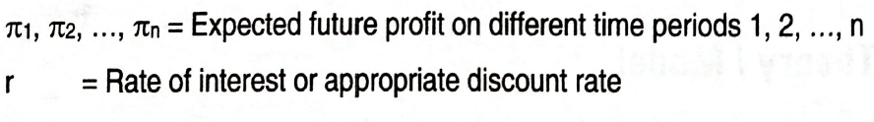
The Theory of The Firm
Managerial Objective
Make choices that increase the value of the firm
The value of the firm is the present value of future profits

Slide 31

Why are Managerial choices important?
because they influence total revenue by managing demand
because they influence total cost by managing production
because they influence the relevant interest rate by managing finances and risk

Slide 32

What are the Managerial Constraints?
Available Technologies
Scarcity of Resources
Legal Limitations

Slide 33

What is Profit?
Two Measures of Profit
Accounting Profit
Economic Profit

Slide 34

Before Accounting/Business Profit and Economic Profit
Explicit Cost
Implicit Cost
Economic Cost
Notes:
Cost

Slide 35
Before Accounting/Business Profit and Economic Profit
Explicit Cost: It is the payment made by a firm for the use of inputs purchased or hired from outside or others. It is the cost of inputs which requires on expense of money by the firm. For eg. wages to the hired labor, interest on borrowed capital, rent on land and buildings, expenditure on raw materials etc. that appear in books of account of the firm. So it is also known as Accounting Cost.
Notes:
Cost

Slide 36
Before Accounting/Business Profit and Economic Profit
Implicit Cost: It is the value of factors owned and used by the firm on the process of production. For eg. entrepreneur’s own capital investment, entrepreneur working in his own firm as manager. If s/he lends out theses factors to others s/he earns rent, wages, interest – this is the implicit cost (opportunity cost).
Economic Cost = Explicit Cost + Implicit Cost
Notes:
Cost

Slide 37
Types of Profit
Accounting or Business Profit : Sales Revenue minus the explicit or accounting cost of doing business.
Business Profit (Accounting Profit)
= Total Revenue – Explicit Costs/Accounting Cost
Explicit cost is the price of inputs hired or purchased from outside
Notes:
Historical costs, legal compliance, reporting requirements
* The accountant is concerned with controlling the firm’s day- today operations, detecting fraud and embezzlement, satisfying tax and other laws, and producing records for various interested groups

Slide 38
Types of Profit
Economic Profit: Sales Revenue minus economic costs (explicit cost + implicit cost).
Economic Profit
= Total Revenue – Economic Costs
= Total Revenue – (Explicit Costs + Implicit Costs)
Implicit cost is the price of inputs owned and used by entrepreneur himself.
Notes:
Market value; opportunity, or implicit cost
* The economist is concerned with decision making, rational choice among strategies
* A more useful measure for managerial decision making

Slide 39
NUMERICAL Example #1
A woman is working in a large garment factory earning Rs. 15,000 per month who decides to open a small tailoring shop of her own. She runs the operating by herself without hired help and invests no money of her own. She takes premises and machines on rent for Rs.10,000 per month and Rs.30,000 per month respectively. She spends Rs.15,000 per month on supplies, electricity, telephone and so on. During the month her gross earning or total revenue is Rs.65,000.
How much are the explicit costs of this business?
How much are the implicit costs of this business?
Calculate economic costs.
Calculate business profit and economic profit.
Should this woman remain in business?
Notes:
Market value; opportunity, or implicit cost
* The economist is concerned with decision making, rational choice among strategies
* A more useful measure for managerial decision making

Slide 40
NUMERICAL Example #1 - Solution
A woman is working in a large garment factory earning Rs. 15,000 per month who decides to open a small tailoring shop of her own. She runs the operating by herself without hired help and invests no money of her own. She takes premises and machines on rent for Rs.10,000 per month and Rs.30,000 per month respectively. She spends Rs.15,000 per month on supplies, electricity, telephone and so on. During the month her gross earning or total revenue is Rs.65,000.
How much are the explicit costs of this business?
= Rent of Premises + Rent of Machines + Expenses on Supplies,
electricity, telephone etc.
= 10,000 + 30,000 + 15,000
= Rs. 55,000
Notes:
Market value; opportunity, or implicit cost
* The economist is concerned with decision making, rational choice among strategies
* A more useful measure for managerial decision making

Slide 41
NUMERICAL Example #1 - Solution
A woman is working in a large garment factory earning Rs. 15,000 per month who decides to open a small tailoring shop of her own. She runs the operating by herself without hired help and invests no money of her own. She takes premises and machines on rent for Rs.10,000 per month and Rs.30,000 per month respectively. She spends Rs.15,000 per month on supplies, electricity, telephone and so on. During the month her gross earning or total revenue is Rs.65,000.
b. How much are the implicit costs of this business?
= Foregone earnings of Precious job
= Rs. 15,000
Notes:
Market value; opportunity, or implicit cost
* The economist is concerned with decision making, rational choice among strategies
* A more useful measure for managerial decision making

Slide 42
NUMERICAL Example #1- Solution
A woman is working in a large garment factory earning Rs. 15,000 per month who decides to open a small tailoring shop of her own. She runs the operating by herself without hired help and invests no money of her own. She takes premises and machines on rent for Rs.10,000 per month and Rs.30,000 per month respectively. She spends Rs.15,000 per month on supplies, electricity, telephone and so on. During the month her gross earning or total revenue is Rs.65,000.
c. Calculate economic costs.
= Explicit Cost + Implicit Cost
= 55,000 + 15,000
= 70,000
Notes:
Market value; opportunity, or implicit cost
* The economist is concerned with decision making, rational choice among strategies
* A more useful measure for managerial decision making

Slide 43
NUMERICAL Example #1 - Solution
A woman is working in a large garment factory earning Rs. 15,000 per month who decides to open a small tailoring shop of her own. She runs the operating by herself without hired help and invests no money of her own. She takes premises and machines on rent for Rs.10,000 per month and Rs.30,000 per month respectively. She spends Rs.15,000 per month on supplies, electricity, telephone and so on. During the month her gross earning or total revenue is Rs.65,000.
d. Calculate business profit and economic profit.
Business Profit = Total Revenue - Explicit Cost
= 65,000 – 55,000 = Rs. 10,000
Economic Profit = Total Revenue - Economic Cost
= 65,000 – 70,000 = Rs. 5,000 (Loss)
Notes:
Market value; opportunity, or implicit cost
* The economist is concerned with decision making, rational choice among strategies
* A more useful measure for managerial decision making

Slide 44
NUMERICAL Example #1 - Solution
A woman is working in a large garment factory earning Rs. 15,000 per month who decides to open a small tailoring shop of her own. She runs the operating by herself without hired help and invests no money of her own. She takes premises and machines on rent for Rs.10,000 per month and Rs.30,000 per month respectively. She spends Rs.15,000 per month on supplies, electricity, telephone and so on. During the month her gross earning or total revenue is Rs.65,000.
e. Should this woman remain in business?
Since the woman is making the loss of Rs. 5000 per month by being in business for herself, she should not remain in business
Notes:
Market value; opportunity, or implicit cost
* The economist is concerned with decision making, rational choice among strategies
* A more useful measure for managerial decision making

Slide 45



Slide 46

Producers being Self interested and shellfish and hence BAD for society – DECREASES welfare
It is not the benevolence of the butcher, the brewer or the baker that we expect our dinner, but from their regard to their own self interest.
Adam Smith “Wealth of Nations”

Slide 47

What does Profit exhibit?
Measures the quality of managers’ decision- making skills
Measures the performance of the company

Slide 48

What does Profit do?
Encourages good management decisions by linking profit with incentives

Slide 49
Sources of Profit
Innovation
Producing products that are better than existing products in terms of functionality, technology, and style
Risk taking
Future outcomes and their likelihoods are unknown, as are the reactions of rivals.
Exploiting Market Inefficiencies (Market Power)
Building barriers to entry, employing sophisticated pricing strategies, diversifying, and making good strategic production decisions

Slide 50

Managerial Interests and Principal-Agent Problem
The interests of a firm’s owners and those of its managers may differ, unless the manager is the owner.

Slide 51
Managerial Interests and Principal-Agent Problem
Separation of ownership and control
The principals are the owners.
•They want managers to maximize the value of the firm.
The agents are the managers.
•They want more compensation and less accountability.
The divergence in goals is the principal-agent problem.

Slide 52
Managerial Interests and Principal-Agent Problem
Moral Hazard
Moral hazard exists when people behave differently when they are not subject to the risks associated with their behavior.
Managers who do not maximize the value of the firm may do so because they do not suffer as a result of their behavior.

Slide 53
Managerial Interests and Principal-Agent Problem
Solutions
Devise methods that lead to convergence of the interests of the firm's owners and its managers
Examples: Stock option plans or bonuses linked to profits

Slide 54
Hoover, based in Merthyr Tydfil, is a major British manufacturer of household appliances including vacuum cleaners and washing machines. In Autumn 1992, Hoover's management launched a special promotion offering two free air tickets to any customer who purchased an appliance at a price of £100 (British pounds) or more. The tickets were valid for round-trip travel to continental Europe or the United States. Each ticket was worth over £200.
How could Hoover's promotion be expected to affect its sales of appliances?

Slide 55
The National Football League (NFL) controls major league American foot ball teams such as the Chicago Bears and the San Francisco Rangers. NFL teams play a series of home and away games during the regular season. The teams derive revenue from sales of tickets and concession items such as food, beverages, and souvenirs at live games. They also earn substantial income from television broadcasting, but this is limited to away games.
Should the owners of NFL teams allow live broadcasting of home games? Why?

Slide 56
An American's average income is over $20,000 a year. By contrast, with an average income of less than $1000 a year, the people of India are among the world's poorest. Yet, in 1991, they purchased over 80,000 air conditioners at a retail price of about $600 per unit.
How could anyone afford these appliances?
Starting from scratch in the early 1980s, the United States' mobile phone industry is projected to reach 60 million subscribers by the year 2000. Typically, mobile phone operators set a two-part pricing scheme, consisting of a basic monthly fee covering a specified quantity of airtime plus a rate for additional minutes.
How should a mobile phone operator determine the basic monthly charge?

Slide 57
How can these problems be addressed?
How could Hoover's promotion be expected to affect its sales of appliances?
Should the owners of NFL teams allow live broadcasting of home games? Why?
How could anyone afford these appliances?
How should a mobile phone operator determine the basic monthly charge?

Slide 58
DEMAND & SUPPLY

Slide 59
Demand & Supply : Where do they meet?
Market
A group of firms and individuals that interact with each other to buy or sell a good
Part of an economy's infrastructure
A social institution that exists to facilitate economic exchange
Relies on binding, enforceable contracts

Slide 60




Which one of the following is Demand?
IRS 9 Crore
IRS 1.2 Crore
To have Rolls Royce Phantom Limousine
To have Ducati 1299 Superleggera
To have Italian Boarini Milanesi bag
IRS 53 Crore
Notes:
Starting price for RR Phantom 9 crore in India price for Ducati 1299 Superleggera is IRS 1.2 Crore boarini milanesi bag 53 Crore IRS

Slide 61

What makes Demand - the Demand?
Wish to have something
Desire to have something
Want to have something
Ability to pay for something
Willingness to pay for something

Slide 62

Demand
Your desire to have commodity with the ability and willingness to pay for it combined together will be - demand

Slide 63

What determines Demand?
Price of the Commodity
Price of Substitute Goods
Price of Complement Goods
Income of the Producer
Taste and Preference of the Companies
Season
Culture
Expectation of Rise or Fall in Price by the Firm
Population
Income Distribution

Slide 64
Demand Side of Market: Determinants
D_{x} = f (P_{x}, P_{R},Y, T, E,N,Y_{d},A…...)
D_{x} = Demand for commodity X
P_{x} = Price of commodity X
P_{R}= Price of related goods
(Substitute and Complementary)
Y = Income of the consumers
T = Taste and preference
E = Expectations of the buyers
N = Population
Y_{d}= Income distribution

Slide 65

Demand Side of Market: Substitutes
These are those goods which are an alternative to one another in consumption eg. Tea or coffee, Pepsi or Coca cola
A fall in the price of substitute good say Y, leads to a fall in the quantity demanded of good X and vice versa

Slide 66

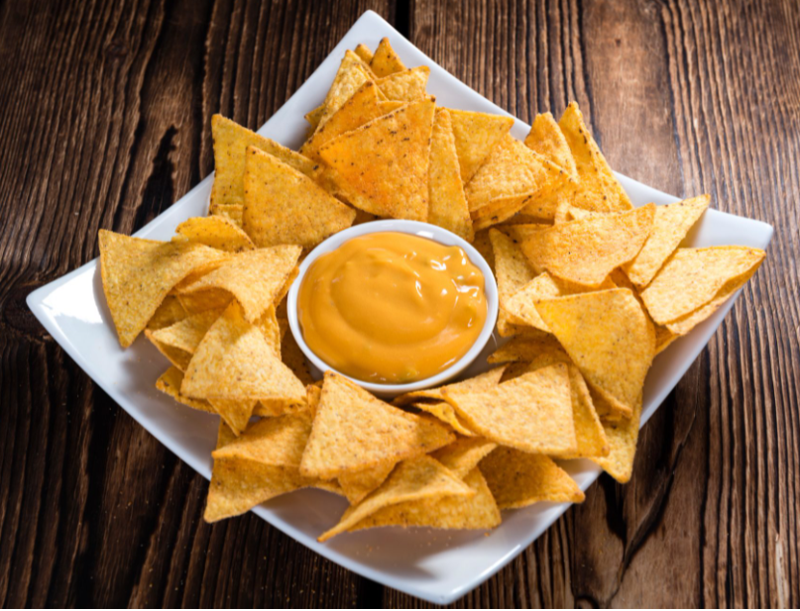
Demand Side of Market: Complements
They are those goods which are jointly used or consumed together to satisfy a want eg. Tea and sugar, bread and butter.
A fall in the price of complementary good say Y, leads to a rise in the quantity demanded of good X and vice versa

Slide 67
Demand Side of Market: Income
Normal Vs. Inferior Goods
If X is a Normal Good, then with the increase n the income, consumer buys more of the good. It has positive income effect.
If X is an Inferior Good, then with the increase in the income, consumer buys less of the good. Eg. Coarse Grains. It has negative income effect.

Slide 68






Which one is the inferior good?

Slide 69
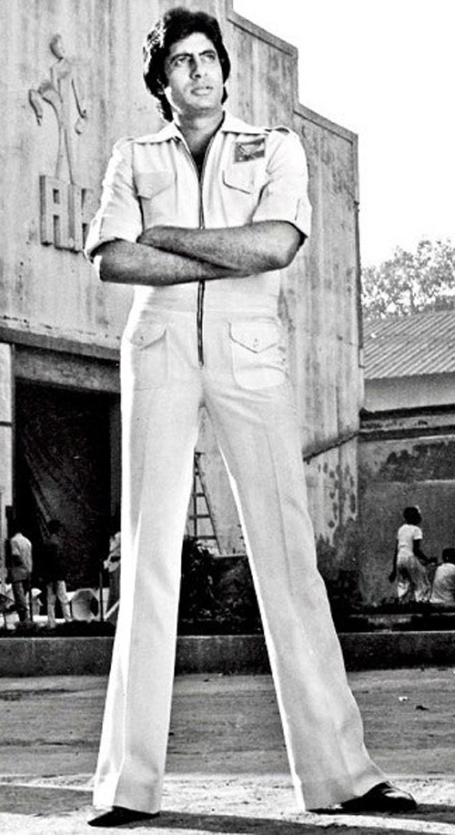

Demand Side of Market: Preferences
A positive taste and preference for good X leads
to a rise in the quantity
demanded of good X
and vice versa.

Slide 70

Demand Side of Market: Expectations
If consumers expect a rise in price of good X in near future it leads to a rise in the quantity demanded of good X and vice versa.

Slide 71

Demand Side of Market: Population
With a rise in population, it leads to a rise in the quantity demanded of goods and vice versa.

Slide 72
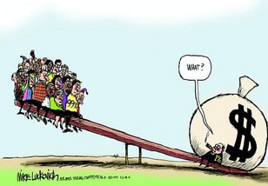
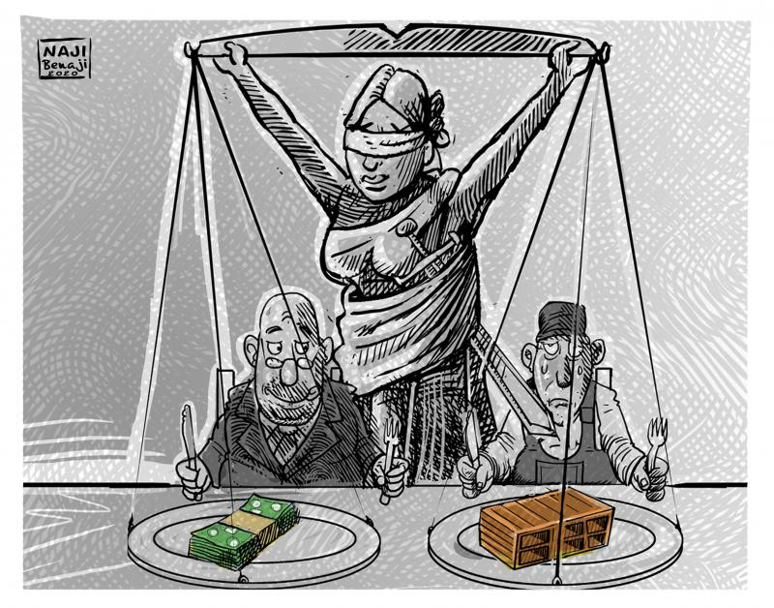
Demand Side of Market: Y Distribution
With an equitable distribution of income leads to a rise in the quantity demanded of goods and vice versa.

Slide 73




Demand Side of Market: Advertisement
Effective advertisement leads to a rise in the quantity demanded of goods and vice versa.

Slide 74
Demand Side of Market: Law of Demand
There is an inverse relationship between the price of a commodity and the quantity demanded of that commodity.
D_{x} = f (P_{x}), ceteris paribus (other things remaining
constant)
where, D_{x} = quantity demanded of good X
P_{x} = price of the good X
Price
Quantity

Slide 75
What happens to Demand if only the Price of the product changes?
Price
B
P1
A
P
C
P2
D
O
Q1
Q
Q2
Quantity

Slide 76
What happens to TR when the Price of the product changes?
Price
TR = P x Q
B
P1
A
P
What does it imply???
C
P2
Change in price affects the TR
D
O
Q1
Q
Q2
Quantity

Slide 77
Demand Side of the Market
Total Revenue Function
A firm's total revenue (TR) for a given time period is equal to the price charged (P) times the quantity sold (Q) during that time period.
TR = P X Q
The demand function reflects the effect of changes in P on quantity demanded (Q) per time period and, hence, the effect of changes in P on TR.

Slide 78

How Supply is Created?

Slide 79
Which one is the Supply?
Razia has 3000 laptops in warehouse and 25 in her showroom and1000 in customs. So supply is 4025 laptops.
B. Razia has 3000 laptops in warehouse and 25 in her showroom. So supply is 25 laptops.
C. Razia has made full payments of only 2000 laptops till date and 1000 are on credit. So supply is 2000 laptops.

Slide 80
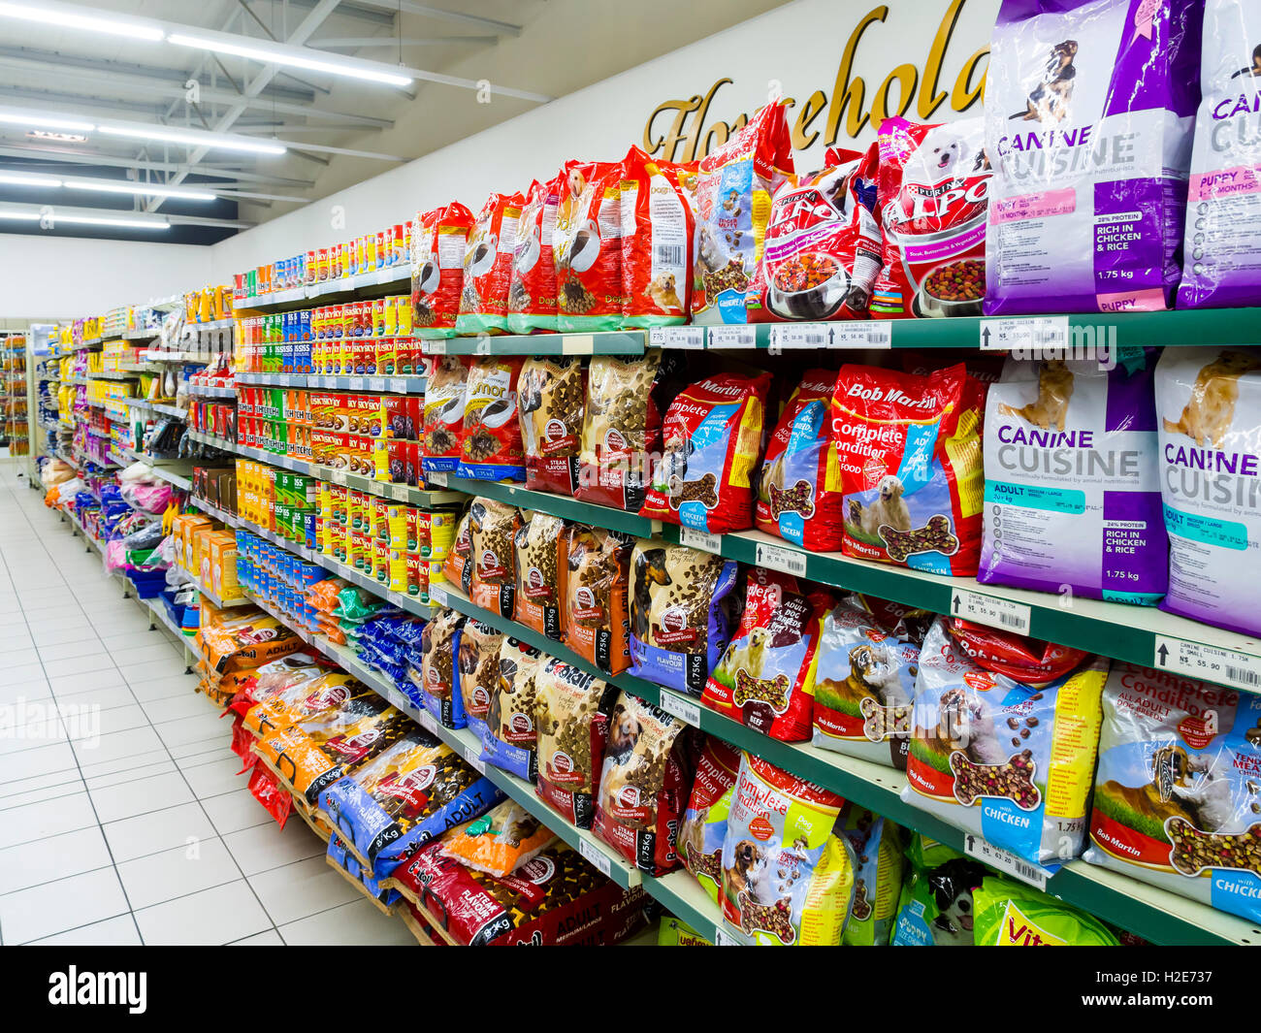

Supply and Stock
Stock of a commodity is the total quantity that is available in the market at a certain time.
Supply is that part of the stock which a seller is ready to sell at a certain price during a certain time. Thus, supply is the part of stock which is actually brought into the market.

Slide 81
What determines Supply?
Price of the Commodity
Price of Related Goods
Income of the Consumer
Taste and Preference of the Firms
Number of Firms
Culture
Expectation of Rise or Fall in Price by the Firm
Population
Income Distribution

Slide 82
Supply Side of Market: Determinants
S_{x} = f (P_{x}, P_{Z}, N_{F,} T, P_{F}, Ex , GP)
S_{x} = Supply of commodity X
P_{x} = Price of commodity X
P_{Z}= Price of related goods
N_{F} = Number of Firms
T = Technological changes
P_{F} = Price of factors of production
E_{X} = Expected Future Price
G_{P} = Government Policy

Slide 83

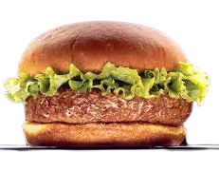
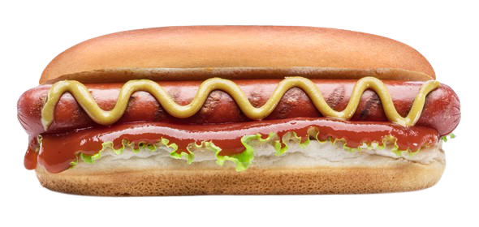
Supply Side of Market: Price of Related Goods
A fall in the price of a related good say Y, leads to a rise in the quantity supplied of good X and vice versa.

Slide 84


Supply Side of Market: Number of Firms
Increase in the number of firms in the market implies increase in supply and vice versa.

Slide 85

Supply Side of Market: Technology
Improvement in the technique of production reduces cost of production. This leads to increase in profit and hence an increase in supply.

Slide 86
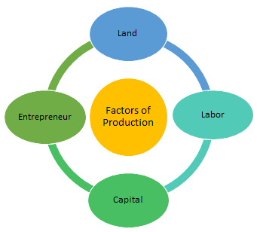
Supply Side of Market: Price of Factors of Production
If the factor price reduces, cost of production also reduces and supply increases and vice versa.

Slide 87


Supply Side of Market: Expected Future Price
If the producer expects the price of the commodity to increase in near future, current supply of the commodity would reduce and vice versa.

Slide 88


Supply Side of Market: Government Policy
Increase in Taxation tends to reduce the supply while increase in Subsidy tends to induce greater supply of the commodity.

Slide 89
Supply Side of Market: Law of Supply
There is a direct relationship between the price of a commodity and the quantity supplied of that commodity.
S_{x} = f (P_{x}), ceteris peribus
where,
S_{x} = quantity supplied of good X
P_{x} = price of the good X
Price
Quantity

Slide 90
What happens to Supply if only the Price of the product changes?
Price
S
B
P1
A
P
C
P2
O
Q2
Q
Q1
Quantity

Slide 91
What happens to TR when the Price of the product changes?
Price
S
B
TR = P x Q
P1
A
P
C
P2
Change in price affects the TR
O
Q2
Q
Q1
Quantity

Slide 92
Market Demand
Price
15
14
13
12
11
10
QD by Y
2
3
4
5
6
7
QD by Z
3
4
5
6
7
8
QD by X
1
2
3
4
5
6
QD by X
1
2
3
4
5
6
QD by Y
2
3
4
5
6
7
QD by Z
3
4
5
6
7
8
Market Demand
6
9
12
15
18
21

Slide 93



Market Demand
MARKET
Price
Demand Curve for X
Price
Price
Price
Demand Curve for Y
Market Demand Curve
Demand Curve for Z
12
12
12
12
11
11
11
11
4
5
5
6
6
7
15
18
Quantity Demanded

Slide 94
Market Supply
Price
15
14
13
12
11
10
QS by Z
8
7
6
5
4
3
QS by X
6
5
4
3
2
1
QS by Y
7
6
5
4
3
2
QS by X
6
5
4
3
2
1
QS by Y
7
6
5
4
3
2
QS by Z
8
7
6
5
4
3
Market Supply
21
18
15
12
9
6

Slide 95



Market Supply
Price
Price
Price
Price
MARKET
Supply Curve for X
Supply Curve for Y
Supply Curve for Z
Market Supply Curve
12
12
12
12
11
11
11
11
2
3
3
4
4
5
9
12
Quantity Supplied

Slide 96
Market Equilibrium
Price
S
E
P
D
O
Q
Quantity

Slide 97
Market Equilibrium
Equilibrium Price
Quantity demanded is equal to quantity supplied.
Price is stable.
The market is in balance because everyone who wants to purchase the good can, and every seller who wants to sell the good can.

Slide 98

Can Market be in Disequilibrium?
When can Market be in Disequilibrium?
Market Disequilibrium- Consequences?

Slide 99
Market Equilibrium
Price
S
Excess Supply
P1
E
P
P2
Excess Demand
D
O
Q
Quantity

Slide 100
Market Disequilibrium
Price Higher than Equilibrium Price
Excess supply
Surplus
Causes price to fall
Price Lower than Equilibrium Price
Excess demand
Shortage
Causes price to rise

Slide 101
Actual Market Price
If actual price is above equilibrium price, there will be a surplus that puts downward pressure on the actual price.
If actual price is below equilibrium price, there will be a shortage that puts downward pressure on the actual price.
If actual price is equal to equilibrium price, then there will be neither a shortage nor a surplus and price will be stable.

Slide 102

Can Market Equilibrium change?
Why does it Change then?

Slide 103
When Demand Curve Shifts…
To the Right ?????
OR
Increase in Demand
To the Left ?????
Decrease in Demand

Slide 104
Why does the Demand Curve Shift to Right or Left?
When Other Influences Change while Price of the Product is constant.
Income
Prices of substitutes and complements
Advertising expenditures
Taste and Preferences
Expectations of the buyers
Population

Slide 105
What if Demand Curve Shifts?
Increase in Demand
Represented by a rightward or upward shift in the demand curve
Result of a change that makes buyers willing to purchase a larger quantity of a good at the current price and/or to pay a higher price for the current quantity
Will create a shortage and cause the equilibrium price to increase

Slide 106
What if Demand Curve Shifts?
Decrease in Demand
Represented by a leftward or downward shift in the demand curve
Result of a change that makes buyers purchase a smaller quantity of a good at the current price and/or continue to buy the current quantity only if the price is reduced
Will create a surplus and cause the equilibrium price to decrease

Slide 107
Market Equilibrium when D
Price
S
E1
P1
E
A
P
D
O
Q
Q1
Quantity

Slide 108
Market Equilibrium when D
Price
S
B
E
P
E2
P2
D
O
Q2
Q
Quantity

Slide 109
When Supply Curve Shifts…..
To the Right ?????
OR
Increase in Supply
To the Left ?????
Decrease in Supply

Slide 110
Why Supply Curve to Shift to Right or Left?
When Other Influences Change while Price of the Product is constant.
Price of related goods
Number of Firms
Technological changes
Price of factors of production
Expected Future Price
Government Policy

Slide 111
What if Supply Curve Shifts?
Increase in Supply
Represented by a rightward or downward shift in the supply curve
Result of a change that makes sellers willing to offer a larger quantity of a good at the current price and/or to offer the current quantity at a lower price
Will create a surplus and cause the equilibrium price to decrease

Slide 112
What if Supply Curve Shifts?
Decrease in Supply
Represented by a leftward or upward shift in the supply curve
Result of a change that makes sellers willing to offer a smaller quantity of a good at the current price and/or to offer the current quantity at a higher price
Will create a shortage and cause the equilibrium price to increase

Slide 113
Market Equilibrium When Supply
Price
S
E
C
P
E1
P1
D
O
Q
Q1
Quantity

Slide 114
Market Equilibrium when Supply
Price
S
E2
P2
E
P
D
D
O
Q2
Q
Quantity

Slide 115
What Happens if Demand & Supply changes simultaneously?

Slide 116
What if Demand & Supply do not meet at all …. What does it mean?

Slide 117
Sam Robbins, owner and CEO of PC Solutions, arrived at the office and glanced at the front page of The Wall Street Journal waiting on his desk. One of the articles contained statements from executives of two of South Korea’s largest semiconductor manufacturers— Samsung Electronic Company and Hynix Semiconductor—indicating that they would suspend all their memory chip production for one week. The article went on to say that another large semiconductor manufacturer was likely to follow suit. Collectively, these three chip manufacturers produce about 30 percent of the world’s basic semiconductor chips.
PC Solutions is a small but growing company that assembles PCs and sells them in the highly competitive market for “clones.” PC Solutions experienced 100 percent growth last year and is in the process of interviewing recent graduates in an attempt to double its workforce.
After reading the article, Sam picked up the phone and called a few of his business contacts to verify for himself the information contained in the Journal. Satisfied that the information was correct, he called the director of personnel, Jane Remak.

Slide 118
What do you think Sam and Jane discussed?
Sam recognized that a cut in chip production will ultimately lead to higher chip prices.
Since chips are a key input in the production of PCs, an increase in the price of chips would in turn lead to a decrease in the market supply of PCs
Sam and Jane discussed the wisdom of going ahead with their plan to double PC Solutions’ workforce at this time.

Slide 119
Elasticity of Demand & Supply
NEXT

